Slide 1
How "Garbage Collection" Works in Java?
Garbage Collector

Slide 2
What is Garbage Collection
In C/C++, programmer is responsible for both creation and destruction of objects. Usually programmer neglects destruction of useless objects. Due to this negligence, at certain point, for creation of new objects, sufficient memory may not be available and entire program will terminate abnormally causing OutOfMemoryErrors.
But in Java, the programmer need not to care for all those objects which are no longer in use. Garbage collector destroys these objects.
Garbage collector is best example of Daemon Thread as it is always running in background.
Main objective of Garbage Collector is to free heap memory by destroying unreachable objects.

Slide 3
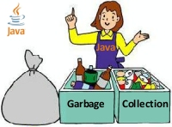
Java – Garbage Collector - Funny

Slide 4
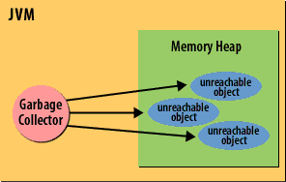

Slide 5
Assignment: To Learn Garbage Collector Mechanism in Java

Slide 6
class Student{
int a;
int b;
public void setData(int c,int d){
a=c;
b=d;
}
public void showData(){
System.out.println("Value of a = "+a);
System.out.println("Value of b = "+b);
}
public static void main(String args[]){
Student s1 = new Student();
Student s2 = new Student();
s1.setData(1,2);
s2.setData(3,4);
s1.showData();
s2.showData();
//Student s3;
//s3=s2;
//s3.showData();
//s2=null;
//s3.showData();
//s3=null;
//s3.showData();
}}

Slide 7
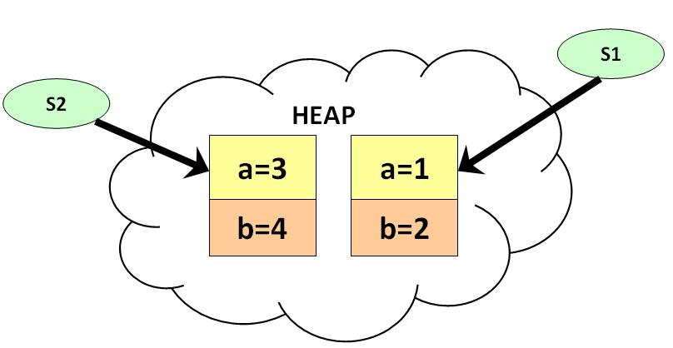
Save, Compile and Run the code. As shown in the diagram , two objects and two reference variables are created.

Slide 8
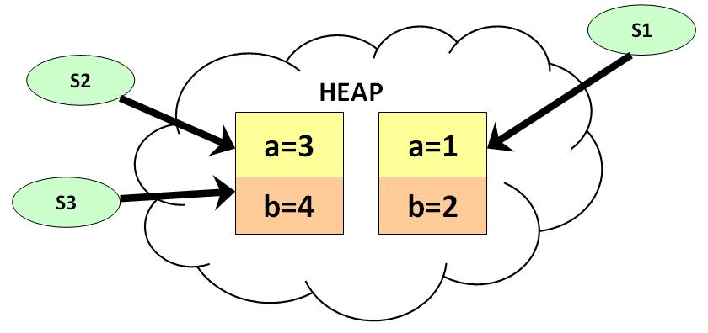
Uncomment line # 20,21,22. Save , compile & run the code. As show in diagram below, two reference variables are pointing to the same object.

Slide 9
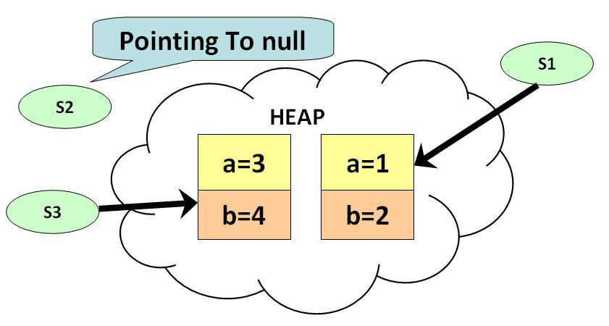
Uncomment line # 23 & 24. Compile , Save & Run the code As show in diagram below , s2 becomes null , but s3 is still pointing to the object and is not eligible for java garbage collection.

Slide 10
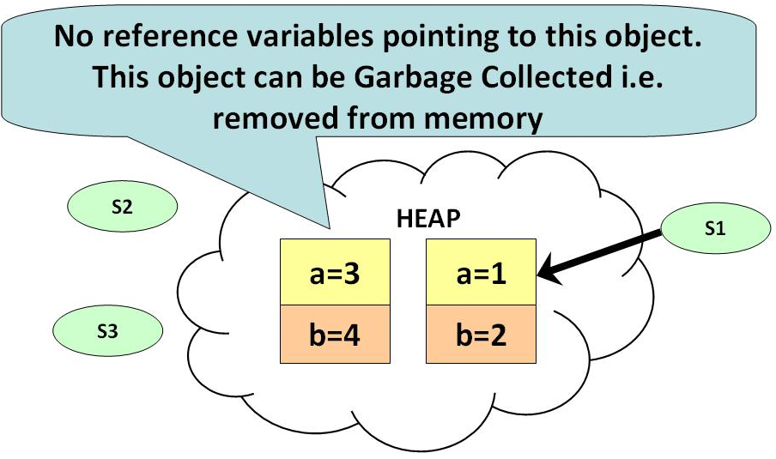
Uncomment line # 25 & 26 . Save , Compile & Run the Code At this point there are no references pointing to the object and becomes eligible for garbage collection. It will be removed from memory and there is no way of retrieving it back.

Slide 11

Garbage Collection Important Points to Note:
1) If you want to make your object eligible for Garbage Collection , assign its reference variable to null. 2) Primitive types are not objects. They cannot be assigned null.

Slide 12
Ways for requesting JVM to run Garbage Collector
Using System.gc() method : System class contain static method gc() for requesting JVM to run Garbage Collector.
Using Runtime.getRuntime().gc() method : Runtime allows the application to interface with the JVM in which the application is running. Hence by using its gc() method, we can request JVM to run Garbage Collector.

